Slide 1
WS Balance Clean-up

Slide 2




Project Background: WS balance clean-up in WCCS
Simulate WS inventory balance to generate insights for inventory control & management
If no control of the inv. movement and balance, ABI may have risk of under-accrual or over-payment for the discount
Scope
FIFO (First in First out)
BUD/HKOW/HBI/HBO/ISP
12 Months
STW/STR - WCCS
D&A
Finance
Legal
Commercial
BudTech
Simulation & Insights
Project PMO
Update contract
Communication & Execution
DEV & Upgrade
Notes:
ABI has the obligation to settle discount for unclaimed STR volume in WCCS (STW-STR), i.e 100% of STW can be claimed. STRSTW adjustment is booked to accrue the discount for STR not claimed
If there is no control of the movement and balance in WCCS, ABI may have the risk of under-accrual or over-payment for the discount

Slide 3
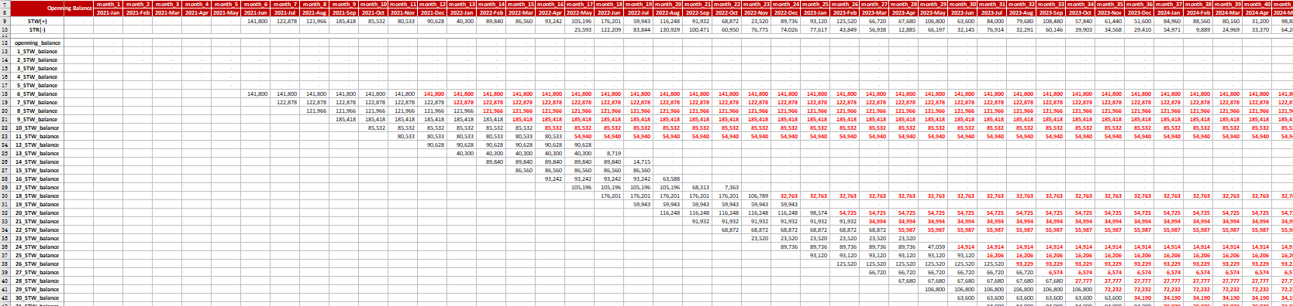
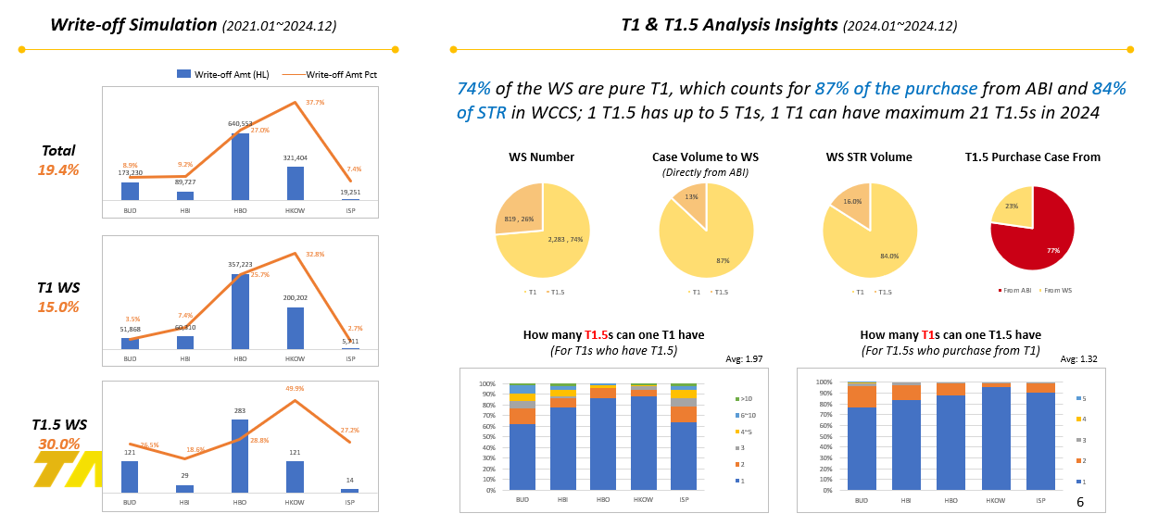
Solution Overview Leverage FIFO method and 4-years’ STW & STR data in WCCS to simulate inv. balance for national WS
Data
Simulation
Output
Data Source: STW & STR in WCCS from 2021 to 2024
WS Scope: National WS
SKU Scope: brand family belongs to “BUD, HBI, HBO, HKOW, and ISP”
Simulation Engine
Simulation per WS
Input Conditions
Freeze Cycle
Unit of Measure
Others…
9 months
12 months
Case
HL
Opening balance
End inv.
Overview and insights
…
FIFO Method
Simulation per WS
Overview & Insights

Slide 4
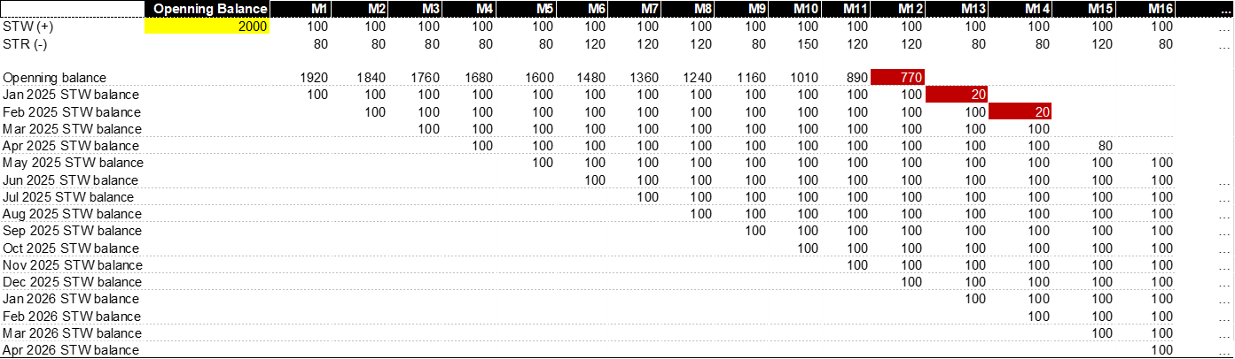
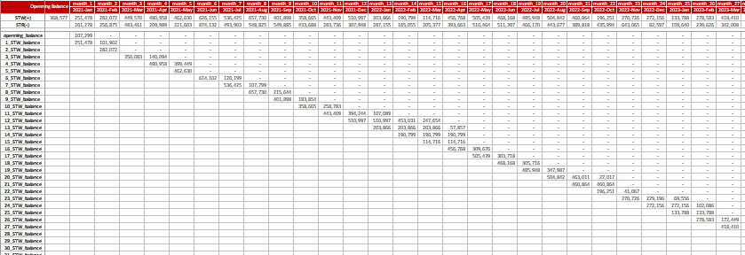
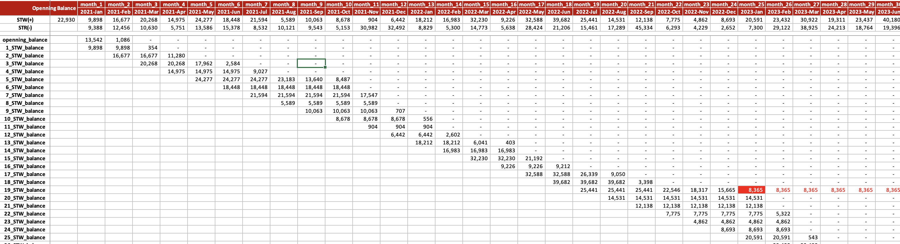
Methodology & Exploration Apply FIFO method, simulate the movement of inv. and provide visibility of the inv. balance for each WS
Methodology
Exploration
FIFO methodology example:
The 3 selected WS show exactly three typical scenarios:
1
No write-off
2
One batch
STW is recorded and divided by different batches, which are generated with the year & month in which the STW occurred
Oldest STW is converted to STR first and in chronological sequence
STW unclaimed after 12 months will be frozen/cleared
3
Multi- batches
Notes:
分batch，FIFO

Slide 5





Key Challenges from Multi-types of WS Different types of WS (T1/T1.5/T2…) have different calc. logics, need to simulate for each sub-divided WS
Data & Logic
New Logic for T1 & T1.5
Case from ABI: 77%
A wholesaler who directly gets beer from ABI, can be further divided into 2 types:
T1 WS: only purchase beer from ABI
T1.5 WS: purchase beer from ABI as well as from other T1 WS
Case to T1.5: 13%
5
2
Case from T1: 23%
T1.5 WS
4
T2.5 WS
Case to T1: 87%
1
1
3
POC
T1 WS
2
POC
For a T1 sending beer to T1.5:
STR is only confirmed after T1.5 sending beer to POCs
T2 WS
1
POC
Other scenarios:
STR is immediately confirmed when the inventory delivery happen
For a T1 WS, STW =
For a T1.5 WS, STW =
1
2
For a T1 WS, STR Calculated =
For a T1.5 WS, STR Calculated =
4
5
1
2
3
T1 send to POC
T1 send to T2
T1.5 send to POCs
T1.5 send to POCs
T1.5 send to T2.5
Note: only include the volume directly from ABI

Slide 6
Results Update
With the new method, ~19% of ending bal. as of Dec. 2024 should be written off
Further analysis of T1 & T1.5 are also listed as below
Write-off Simulation (2021.01~2024.12)
T1 & T1.5 Analysis Insights (2024.01~2024.12)
Write-off Amt (HL)
Write-off Amt Pct
74% of the WS are pure T1, which counts for 87% of the purchase from ABI and 84% of STR in WCCS; 1 T1.5 has up to 5 T1s, 1 T1 can have maximum 21 T1.5s in 2024
Total
19.4%
WS Number
Case Volume to WS
(Directly from ABI)
WS STR Volume
T1.5 Purchase Case From
T1 WS
15.0%
How many T1.5s can one T1 have
(For T1s who have T1.5)
How many T1s can one T1.5 have
(For T1.5s who purchase from T1)
Avg: 1.97
Avg: 1.32
T1.5 WS
30.0%

Slide 7
Project Progress and Next Step
We are here
01
02
03
04
National Simulation
Solution Upgrades
Exploration
Routinization
FIFO Method Exploration
Selected WS Simulation
Solution Alignment
National WS Simulation
Data Engineering
Algorithm Engineering
Solution Upgrades for T1/T1.5 WS
Results refining with end inv.
Simulation results providing by month
(till WCCS finish dev.)

Slide 8
Thank You

Slide 9
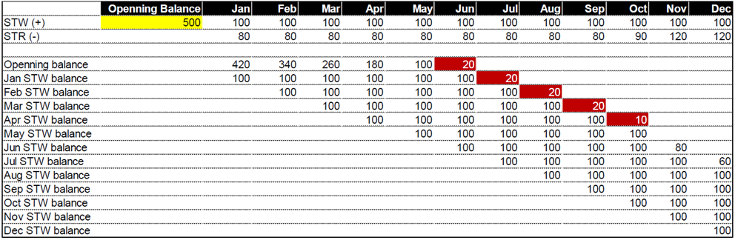
Project Background: WS balance clean-up in WCCS
ABI has the obligation to settle discount for unclaimed STR volume in WCCS (STW-STR), i.e 100% of STW can be claimed. STRSTW adjustment is booked to accrue the discount for STR not claimed
If there is no control of the movement and balance in WCCS, ABI may have the risk of under-accrual or over-payment for the discount
Based on FIFO, STR to be transferred should be from the STW of the earliest months
STW over 12 months but still not transferred will be written off
Add FIFO terms in the contract with WS
D&A
Finance
Legal
Commercial
BudTech / Unisoft
Simulate the inventory of WS based on FIFO
Promote inventory write-off and change of contract terms
Update contract (with FIFO terms)
Communicate with WS about contract renewal
Enhance WCCS system
ETD: end of April
Notes:
可以立刻清的，比较大的经销商，经销商沟通 ①合同条款的变更，②WCCS中能清掉的进行清理 1月上旬

Slide 10
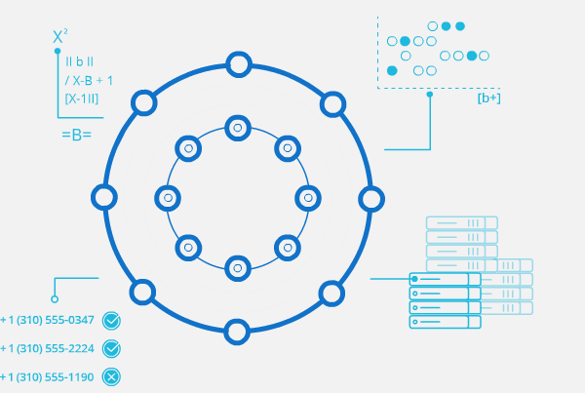
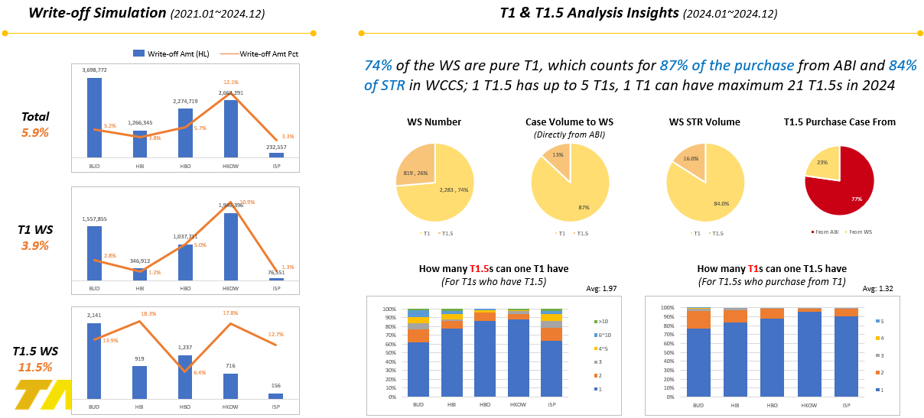
Solution Overview
Data
Simulation
Output
Data Source: STW & STR in WCCS from 2021 to 2024
WS Scope: National WS
SKU Scope: brand family belongs to “BUD, HBI, HBO, HKOW, and ISP”
Calculation Logic: FIFO
Freeze Cycle: 9 or 12 months
Unit of Measure: Case → HL
Simulation per WS
Overview and insights

Slide 11
Phase 3: New Scenario Exploration and Simulation
A wholesaler who directly gets beer from ABI, can be further divided into 2 types:
T1 WS: only purchase beer from ABI
T1.5 WS: purchase beer from ABI as well as from other T1 WS
Business Scenario
Calculation Logic
Case from ABI: 77%
For a T1 WS, STW =
Case to T1.5: 13%
1
2
5
For a T1 WS, STR Calculated =
1
2
3
Case from T1: 23%
T1.5 WS
4
T2.5 WS
T1 send to POC
T1 send to T2
T1.5 send to POCs
Case to T1: 87%
1
1
3
POC
T1 WS
For a T1.5 WS, STW =
Note:
For T1.5, only consider the volume directly coming from ABI
2
POC
2
For a T1.5 WS, STR Calculated =
4
5
T2 WS
T1.5 send to POCs
T1.5 send to T2.5
1
POC
For a T1 wholesaler:
Could only get beer from ABI
Could send beer to a T1.5 wholesaler, to a T2 wholesaler, or directly to POCs
For a T1.5 wholesaler:
Beer from T1 could only to POCs
Beer from ABI could send to a T2.5 wholesaler or POCs
Note:
Wholesaler identity could change in the past
SKU mapping relationship is recorded in master data (not in the order), could change after purchasing from one WS to another
If send different batches to POC/T2/T1.5 in the same month, new batches are given priority to T1.5
Notes:
有STW，从2021年至今没有过STR，可以提供单独清单供大家进行核查
有STR，未曾有STW：
大概率是SKU的mapping关系发生过变更，之前T1.5从其他T1处进货（不会有STW），后面该T1.5可能变为直接从ABI进货（即变为了T1），此时发出的STR会单独记录
要注意，T1和T1.5的身份不是一成不变的，会有身份切换
可write off的库存为什么小于期末库存：
有可能是SKU的mapping关系发生过变更，之前T1.5从T1-A处进货，进货后尚未发出，此时关系变更为从T1-B进货（或者从ABI进货），再出库时，WCCS中记录的上级经销商就是T1-B（或者无上级经销商，如果从ABI进货的话）

Slide 12
Methodology & Exploration First is to explore the FIFO method, provide visibility of the 3 selected WS and align on the methodology for national wholesalers
Methodology
Overview of 3 selected WS
FIFO methodology example:
The 3 selected WS show exactly three typical scenarios:
1
No batch need to
2
A few batches
Next step: national WS overview
3
Majority of batches
1
2
3
Total balance of WS
Total balance
Opening balance + STW
# of batches to be written-off
Notes:
分batch，FIFO

Slide 13
Project Progress and Next Step
4个阶段,
FIFO Method Exploration
3 Selected WS
2021.01~2024.10
With 5 selected brands
New Scenario Simulation
T1 & T1.5 subdivision
Different STR calculation logic
Refined WS Simulation
Compare ending inventory
Exclude specific WS
3 Selected WS Simulation
2023.01~2023.12
National WS Simulation
Data/algo Engineering
Case → HL
T1 Write-off refining
T1 write-off amt are split into T1 & T1.5
Provide analysis data by month (till WCCS finish CR)
Nov.18
2024
Nov.20
Nov.30
Dec.13
Dec.20
Dec.26
Jan.9
2025
Next…
Notes:
Methodology exploration, national simulation, solution upgrades, routine

